Slide 1
Meeting with Teddy
Angioarchitecture data

Slide 2
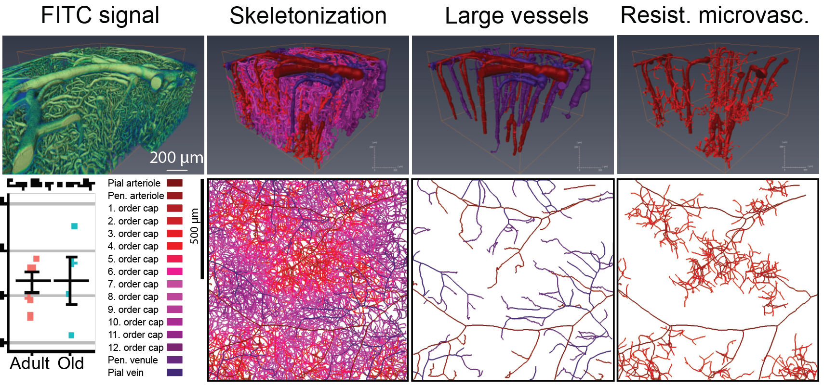
Angioarchitecture

Slide 3
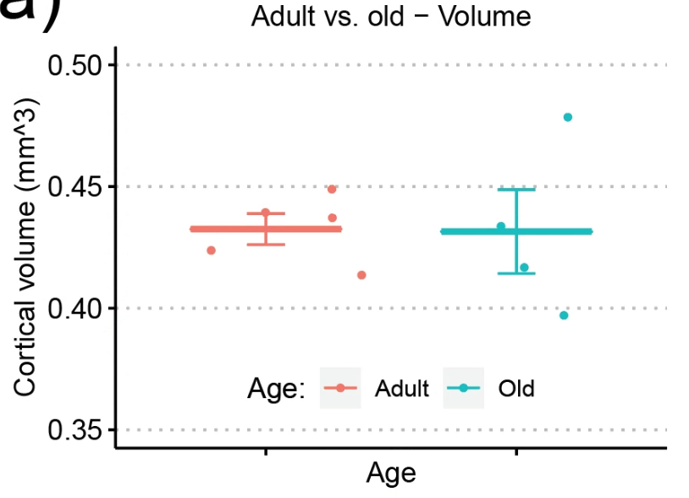
Total cortical area analyzed

Slide 4
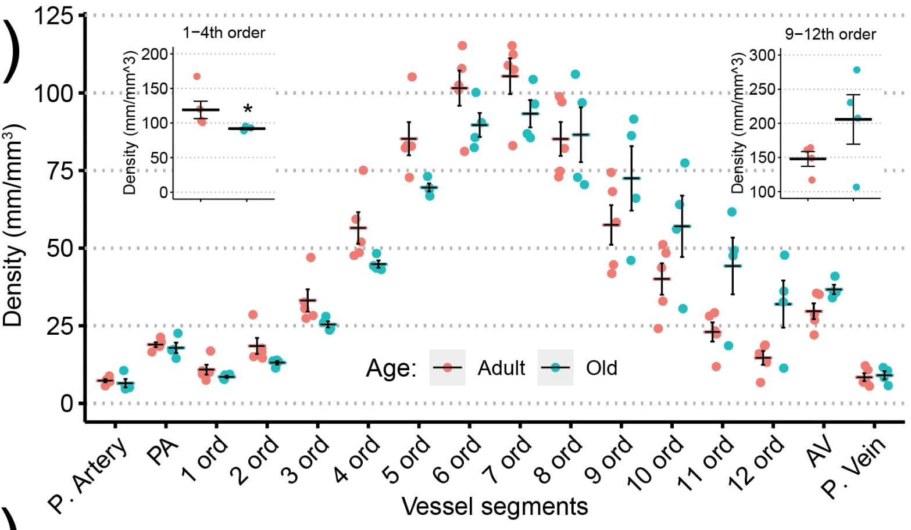
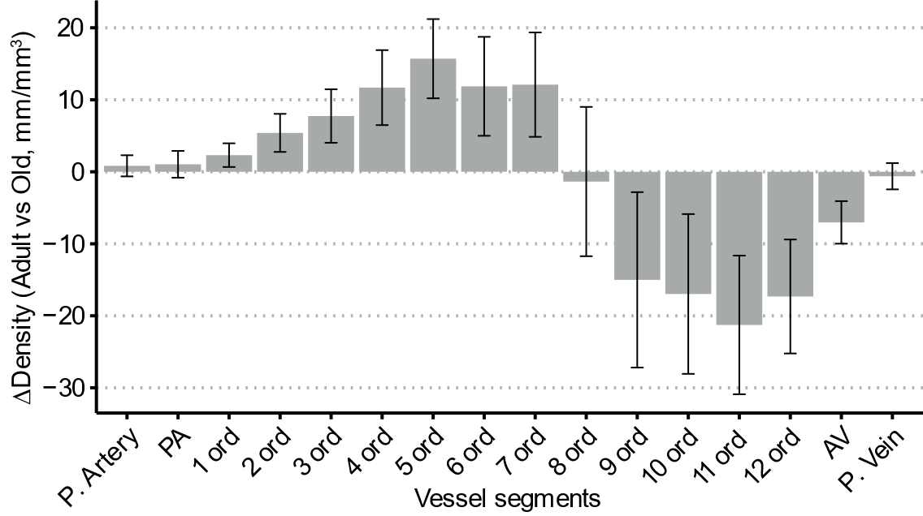
Difference in densities between adult and old

Slide 5
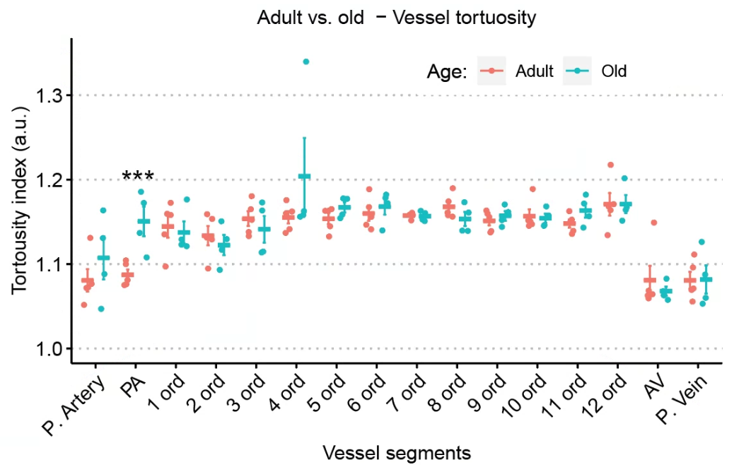
Vessel tortuosity

Slide 6
Angioarchitecture data
Volume = total volume of dataset, multiply by 10^-9 to get in mm^3
CapOrder = Capillary order
CapVesLL = Total capillary length (multiply by 10^6 to get in mm)
CapVesNum = Number of capillaries (multiply by 10^9 to get number)
CapVesVol = Volume of capillaries (do not use)
CapVesDiam = Diameter of capillaries (do not use)
CapVesTortous = Tortuosity of capillaries
CapMeanVesLength = Mean length of capillaries (in um)
MouseID | LocID | Condition | Volume | CapOrder | CapVesLL | CapVesNum | CapVesVol | CapVesDiam | CapVesTortous | CapMeanVesLength
40520 | Loc1 | Adult | 449758697.9 | pa | 1.83354E-05 | 1.66756E-07 | 0.006145656 | 19.65655547 | 1.075208533 | 109.9536629
40520 | Loc1 | Adult | 449758697.9 | 1stCap | 9.40153E-06 | 1.57862E-07 | 0.001322861 | 13.96064986 | 1.172599296 | 59.55522225
40520 | Loc1 | Adult | 449758697.9 | 2ndCap | 1.65086E-05 | 2.91267E-07 | 0.001923133 | 12.53496779 | 1.153571679 | 56.67865779
40520 | Loc1 | Adult | 449758697.9 | 3rdCap | 3.05448E-05 | 5.35843E-07 | 0.002986956 | 11.75731386 | 1.180417137 | 57.00329946
40520 | Loc1 | Adult | 449758697.9 | 4thCap | 4.76183E-05 | 9.16047E-07 | 0.004396244 | 11.37433049 | 1.141417209 | 51.98238893
40520 | Loc1 | Adult | 449758697.9 | 5thCap | 8.22945E-05 | 1.42743E-06 | 0.007507881 | 11.0900214 | 1.163257212 | 57.65212076
40520 | Loc1 | Adult | 449758697.9 | AscVenule | 2.68269E-05 | 7.09269E-07 | 0.00939565 | 20.6548195 | 1.062901442 | 37.8232332
40520 | Loc1 | Adult | 449758697.9 | PialArtery | 7.45728E-06 | 8.89366E-08 | 0.006111234 | 31.2743595 | 1.0718365 | 83.84942575
40520 | Loc1 | Adult | 449758697.9 | PialVein | 6.83187E-06 | 1.02277E-07 | 0.007279819 | 37.86546478 | 1.069475435 | 66.79768913
40520 | Loc1 | Adult | 449758697.9 | 6thCap | 0.000102451 | 1.76984E-06 | 0.009538711 | 11.26565487 | 1.167567915 | 57.88717127
40520 | Loc1 | Adult | 449758697.9 | 7thCap | 0.000107472 | 1.95216E-06 | 0.00974347 | 11.17090661 | 1.158062984 | 55.05304055
40520 | Loc1 | Adult | 449758697.9 | 8thCap | 8.21464E-05 | 1.53416E-06 | 0.007706083 | 11.27581562 | 1.161018232 | 53.54499541

Slide 7
Depth data
Same units as above
MouseID | LocID | Condition | Volume | Depth | DepthVesLL | DepthVesNum | DepthVesVol | DepthVesDiam | DepthVesTortous | DepthMeanVesLength | DepthBranchNum
40520 | Loc1 | Adult | 70710028.98 | 0to100um | 0.000593206 | 1.0601E-05 | 0.133712406 | 13.00940903 | 1.131522326 | 55.95754258 | 8.82477E-06
40520 | Loc1 | Adult | 159358444.8 | 100to200um | 0.000358365 | 6.18845E-06 | 0.035529917 | 10.97901717 | 1.130551236 | 57.90862838 | 4.62479E-06
40520 | Loc1 | Adult | 159506608.2 | 200to300um | 0.000440244 | 6.97942E-06 | 0.047194458 | 11.9079691 | 1.140776816 | 63.07740881 | 5.0907E-06
40520 | Loc1 | Adult | 95777258.92 | 300to400um | 0.000811837 | 1.47085E-05 | 0.092945632 | 12.42791574 | 1.15585295 | 55.19507909 | 1.04409E-05
40520 | Loc1 | Adult | 84316651.31 | 400to500um | 0.000857171 | 1.77571E-05 | 0.097280431 | 12.14368572 | 1.172518478 | 48.27207194 | 1.39E-05
60520 | Loc1 | Adult | 64640065.35 | 0to100um | 0.000607029 | 1.05272E-05 | 0.164956207 | 13.68585031 | 1.134773159 | 57.66316182 | 8.52413E-06
60520 | Loc1 | Adult | 152165413.1 | 100to200um | 0.000374114 | 5.79985E-06 | 0.028734125 | 9.172619719 | 1.159103819 | 64.50403261 | 4.72512E-06
60520 | Loc1 | Adult | 152025898.2 | 200to300um | 0.00038248 | 5.83825E-06 | 0.029239178 | 9.535690303 | 1.149011567 | 65.51279198 | 4.81497E-06
60520 | Loc1 | Adult | 98093183.46 | 300to400um | 0.000770565 | 1.31258E-05 | 0.07018162 | 10.7708433 | 1.14518846 | 58.70627291 | 1.05002E-05
60520 | Loc1 | Adult | 75361351.38 | 400to500um | 0.000814959 | 1.64922E-05 | 0.076752424 | 10.75900489 | 1.16956684 | 49.41477816 | 1.51537E-05
120419 | Loc1 | Adult | 58143161.59 | 0to100um | 0.000686698 | 1.18065E-05 | 0.21264986 | 15.01235045 | 1.1321166 | 58.16259718 | 9.82059E-06
120419 | Loc1 | Adult | 148388084.6 | 100to200um | 0.000378327 | 5.74081E-06 | 0.058909646 | 13.04193948 | 1.14219999 | 65.9013229 | 4.93975E-06
120419 | Loc1 | Adult | 126714140.8 | 200to300um | 0.000558308 | 9.62762E-06 | 0.09620629 | 14.93331281 | 1.142264264 | 57.99022612 | 9.30441E-06
120419 | Loc1 | Adult | 152815670.9 | 300to400um | 0.000502829 | 9.3138E-06 | 0.087604255 | 14.9380237 | 1.150175684 | 53.98755465 | 9.26607E-06
120419 | Loc1 | Adult | 170080649.8 | 400to500um | 0.000333984 | 7.85753E-06 | 0.070881127 | 16.64171473 | 1.143682991 | 42.50492278 | 1.46813E-05
120419 | Loc1 | Adult | 27690369.2 | 500to600um | 0 | 0 | 0 |  |  |  | 8.8984E-05
140120 | Loc1 | Old | 61321009.24 | 0to100um | 0.000780477 | 1.43609E-05 | 0.194985488 | 13.31224014 | 1.146104693 | 54.34751022 | 1.1448E-05
140120 | Loc1 | Old | 129863772.6 | 100to200um | 0.000594744 | 1.03089E-05 | 0.067780866 | 10.36724964 | 1.189903798 | 57.6923812 | 7.76968E-06

Slide 8
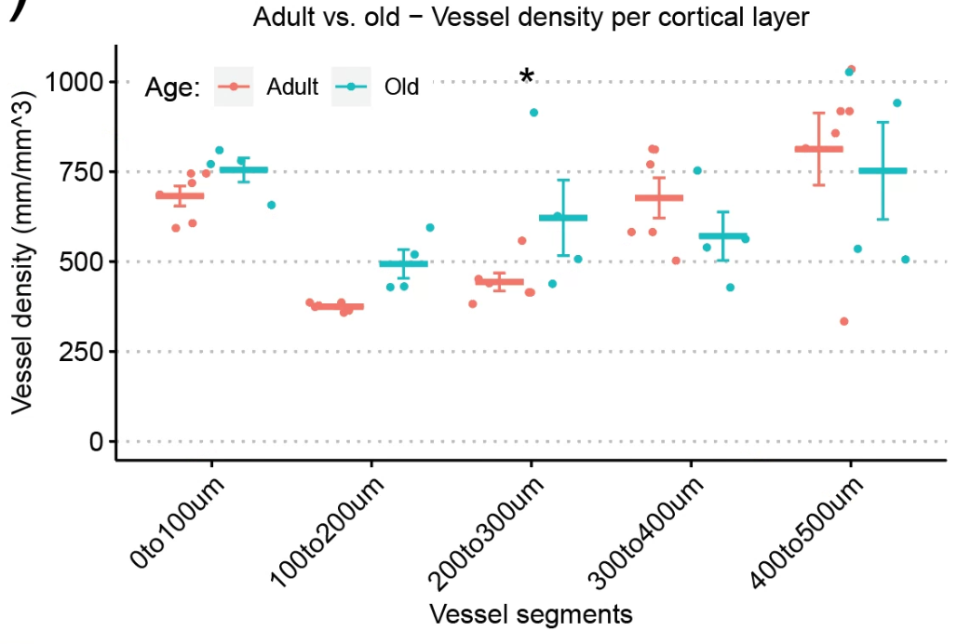
Density vs Depth in adult and old

Slide 9
Comparisons
Total cortical area
Density: Adult vs old
Overall density adult vs old
Resistance vasculature (1-4th order) adult vs old
Venules end capillaries (9-12th order) adult vs old
Bland-Altman plot (differences)
Density vs depth: adult vs old
Vessel tortuosity: adult vs old

Slide 10
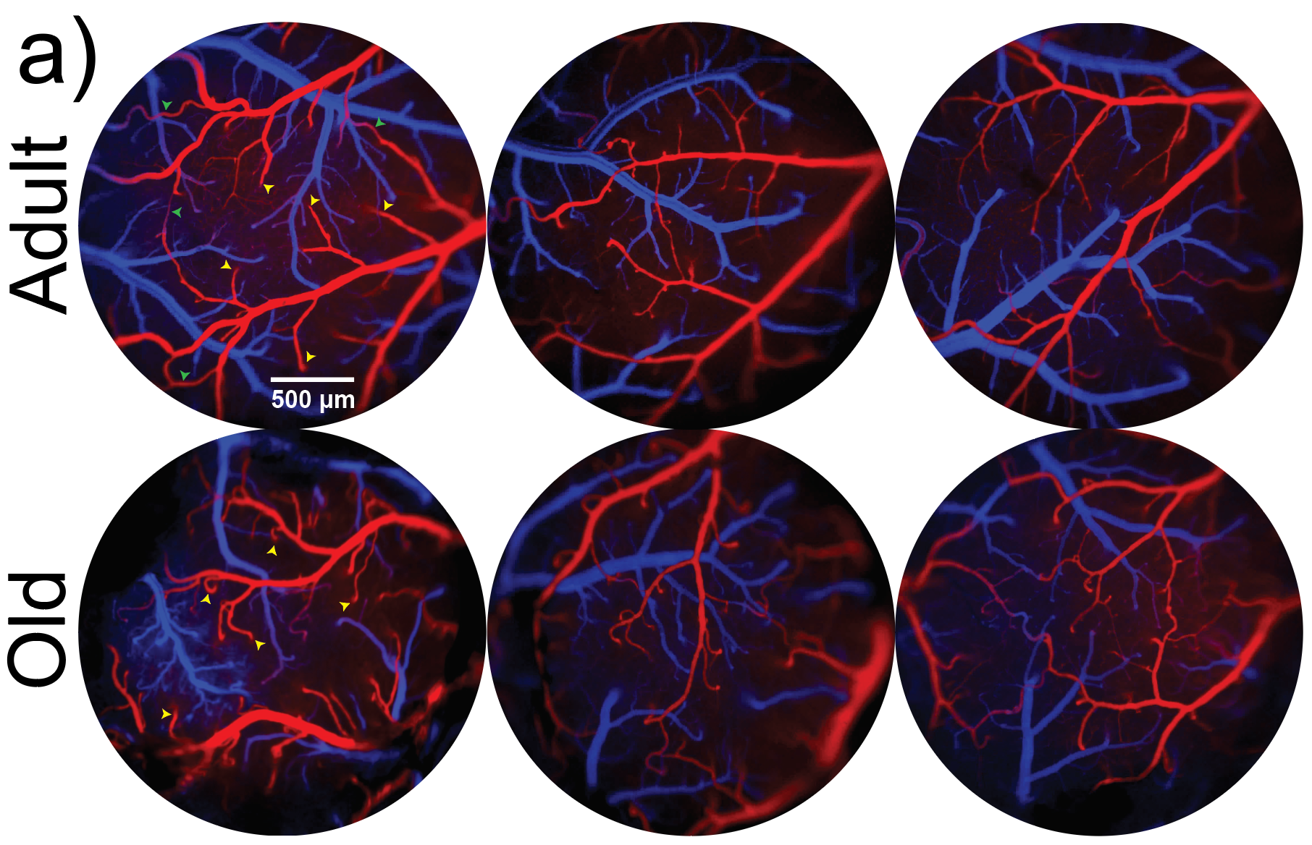
Collaterals from angiograms

Slide 11
Collateral data
Date | Age | Craniotomy_area | Craniotomy_diameter | CollateralNumber | Distance | CurvedLength | Mean_diameter | SD
20920 | Old | 4195947.46 | 2.30986376 | 0
41021 | Old | 7024125.54 | 2.988597831 | 1 | 107.01 | 112.25 | 19.71 | 6.88
41021 | Old | 7024125.54 | 2.988597831 | 2 | 308.92 | 404.11
50520 | Old | 6256999.78 | 2.820683865 | 1 | 258.93 | 299.97 | 24.87 | 5.19
50520 | Old | 6256999.78 | 2.820683865 | 2 | 357.05 | 384.44 | 20.67 | 9.03
50520 | Old | 6256999.78 | 2.820683865 | 3 | 570.02 | 825.12 | 20.9 | 3.99
70720 | Old | 5699666.51 | 2.692130246 | 1 | 433.86 | 504.23 | 22.61 | 9.67
70720 | Old | 5699666.51 | 2.692130246 | 2 | 245.13 | 252.96 | 21.82 | 7.9
70720 | Old | 5699666.51 | 2.692130246 | 3 | 456.2 | 570.56 | 20.12 | 7.76
70720 | Old | 5699666.51 | 2.692130246 | 4 | 259.45 | 332.04 | 23.05 | 9.43
70720 | Old | 5699666.51 | 2.692130246 | 5 | 207.25 | 231.59 | 18.66 | 3.83
70720 | Old | 5699666.51 | 2.692130246 | 6 | 270.78 | 275.4 | 18.74 | 10.19
70720 | Old | 5699666.51 | 2.692130246 | 7 | 415.49 | 530.54 | 20.72 | 8.66
70921 | Old | 5810388.16 | 2.718153118 | 1 | 845.11 | 1001.62 | 18.72 | 2.04
70921 | Old | 5810388.16 | 2.718153118 | 2 | 1222.49 | 1287.34 | 23.36 | 11.07
70921 | Old | 5810388.16 | 2.718153118 | 3 | 909.85 | 1446.57 | 24.83 | 12.48
140120 | Old | 3451355.98 | 2.094914112 | 1 | 662.95 | 802.64 | 17.26 | 8.53
160421 | Old | 5752657.68 | 2.704615983 | 1 | 636.44 | 709.67 | 23.61 | 4.96
160421 | Old | 5752657.68 | 2.704615983 | 2 | 411.17 | 532.36 | 24.12 | 5.64
160421 | Old | 5752657.68 | 2.704615983 | 3 | 237.49 | 259.67 | 21.13 | 7.69
160421 | Old | 5752657.68 | 2.704615983 | 4 | 911.73 | 1249.86 | 28.97 | 5.24
170321 | Old | 4552216.69 | 2.405929005 | 1 | 541.28 | 627.14 | 27.19 | 8.24
170321 | Old | 4552216.69 | 2.405929005 | 2 | 418.59 | 601.94 | 27.16 | 5.87

Slide 12
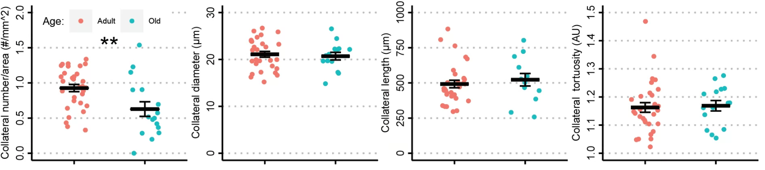
Collateral results

Slide 13
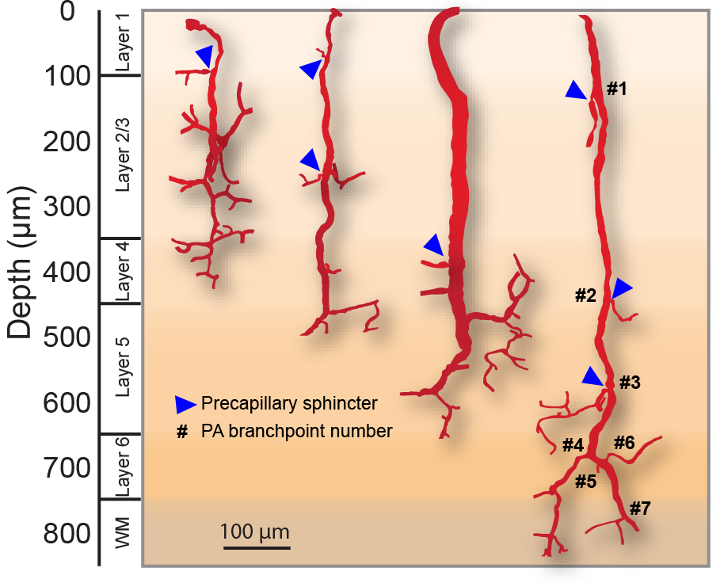
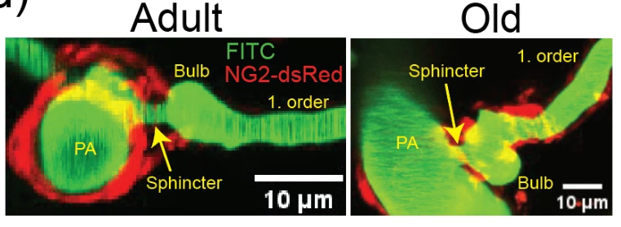
Sphincter quantification

Slide 14
Sphincter quantification data
Date: Mouse number
Age: adult or old
Branch_number: Arteriole branch number
XX_diam: diameter of segment in um
Depth: Depth below cortex in um
Forking: whether the capillary bifurcates at the branch
Neck/1. order: Sphinc_diam/firstord_diam
1. Order / PA: firstord_diam/PA_diam
Date | Age | PA_number | Branch_number | Depth | PA_diam | Sphinc_diam | Bulb_diam | firstord_diam | Forking | Neck/1. order | 1. order / PA | Comments
140120 | Old | 1 | 1 | 40 |  |  |  |  |  |  |  | Arteriole dividing in 2
140120 | Old | 1 | 2 | 212 | 10 | 4 | 8 | 7 |  | 0.571428571 | 0.7
140120 | Old | 1 | 3 | 274 | 10 | 4 | 9 | 6 |  | 0.666666667 | 0.6
140120 | Old | 1 | 4 | 296 | 10 | 5 | 7 | 6 |  | 0.833333333 | 0.6
140120 | Old | 1 | 5 | 314 | 8 | 5 | 4 | 4 |  | 1.25 | 0.5
140120 | Old | 1 | 6 | 351 | 8 | 6 | 6 | 6 |  | 1 | 0.75
140120 | Old | 2 | 1 | 143 | 14 | 2 | 3 | 3 |  | 0.666666667 | 0.214285714 | Sphincter is occluded
140120 | Old | 2 | 2 | 256 |  |  |  |  | Y
140120 | Old | 2 | 3 | 263 | 14 | 5 | 5 | 5 |  | 1 | 0.357142857
140120 | Old | 2 | 4 | 369 | 12 | 7 | 8 | 7 |  | 1 | 0.583333333
140120 | Old | 2 | 5 | 371 | 10 | 9 | 8 | 7 |  | 1.285714286 | 0.7
140120 | Old | 3 | 1 | 65 | 19 | 4 | 10 | 7 |  | 0.571428571 | 0.368421053
140120 | Old | 3 | 2 | 307 | 17 | 9 | 11 | 6 |  | 1.5 | 0.352941176
140120 | Old | 4 | 1 | 329 | 18 | 7 | 10 | 7 |  | 1 | 0.388888889
140120 | Old | 4 | 2 | 481 | 15 | 7 | 10 | 9 |  | 0.777777778 | 0.6
140120 | Old | 5 | 1 | 0 | 16 | 3 | 11 | 7 |  | 0.428571429 | 0.4375
140120 | Old | 5 | 2 | 232 | 14 | 4 | 9 | 5 |  | 0.8 | 0.357142857
140120 | Old | 5 | 3 | 264 | 19 | 8 | 8 | 7 |  | 1.142857143 | 0.368421053
140120 | Old | 6 | 1 | 0 | 14 | 6 | 12 | 9 |  | 0.666666667 | 0.642857143
140120 | Old | 6 | 2 | 249 |  |  |  |  | Y
140120 | Old | 6 | 3 | 356 | 14 | 6 | 9 | 7 |  | 0.857142857 | 0.5
140120 | Old | 6 | 4 | 387 |  |  |  |  | Y
140120 | Old | 7 | 1 | 70 | 8 | 3 | 5 | 5 |  | 0.6 | 0.625
140120 | Old | 7 | 2 | 257 | 10 | 5 | 5 | 6 |  | 0.833333333 | 0.6

Slide 15
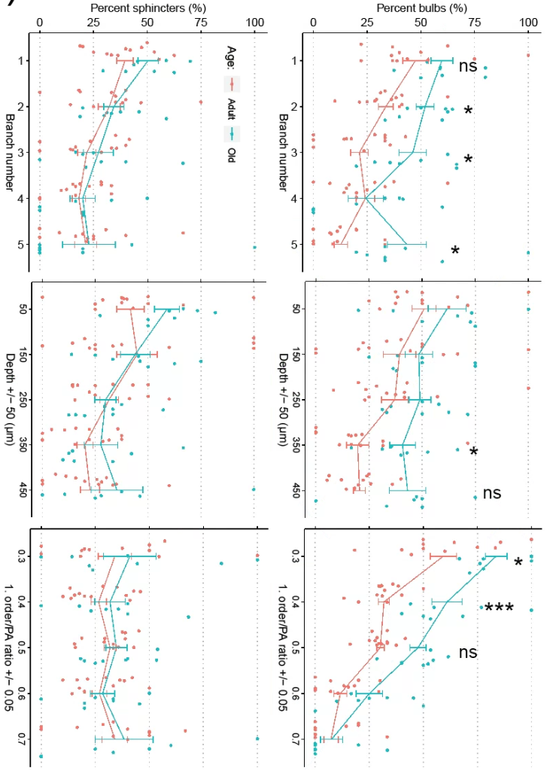
Sphincter quantification data

